Slide 1
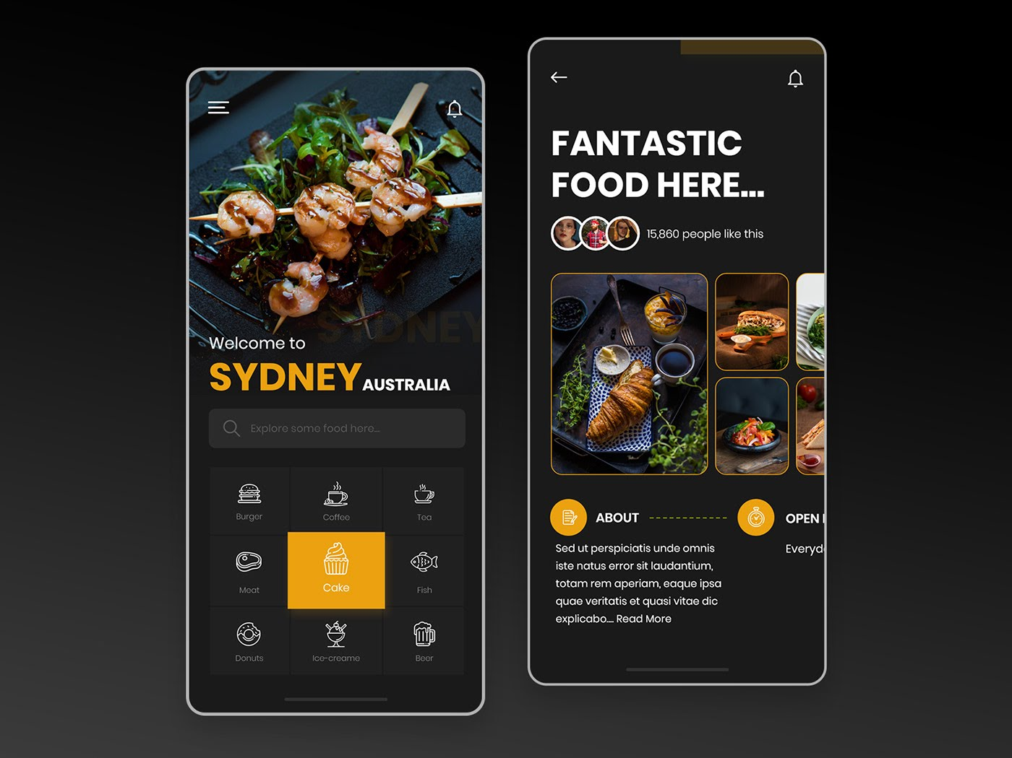

E-CUISINE APP
By : Abhinav Vaid
Akanksha
Akhilesh Parihar
Sarinderpal Singh

Slide 2
WHAT IT IS?
E-Cuisine app provides a wide range of advantages like whether on a break, stuck in traffic or riding the bus, virtually anyone can place an order quickly and painlessly.
With online food ordering app, all preferences are specified directly by the customer, so there is no room for confusions or misunderstandings. It’s a service which is open to its customer 24*7. By using an online food ordering system, you can give your clients the flexibility to place the orders whenever it’s most convenient for them.
Switching the focus from offline ordering to online ordering means less hassle of handling undecided calling clients and the staff time lost in the process and that means significant money savings for the customers.

Slide 3
FEATURES
1
2
3
4
Client Side Welcome Page Sign-In Sign-up
User Panel and Menu Page
Food Description and add to cart
View and submit order
5
6
7
8
Server Side Welcome Page Sign/In
Create Category Delete Category Update Category
Create New Food Update Food Delete Food
Order Management

Slide 4
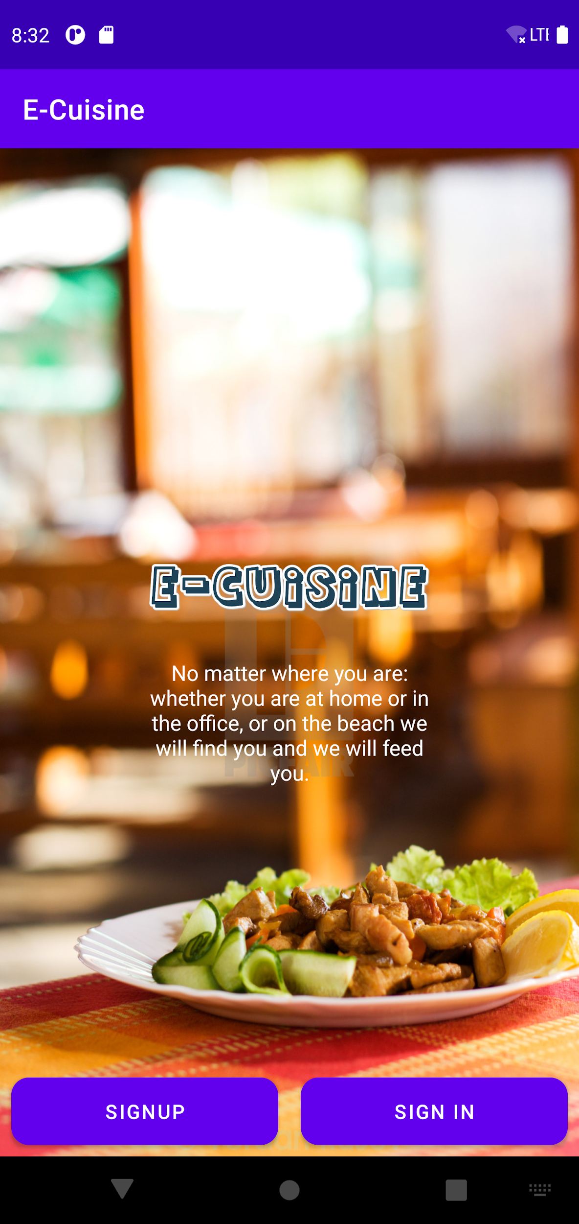
OUR FIRST SPRINT
A sprint is an iteration in the development cycle of a project. The sprint is defined by a small amount of planned work that the team has to complete and ready for review.
Create User Interface for register and login User
Create Database
adding User to database on SIGN UP
Authenticate User while SIGN IN with database
Create User Interface for Viewing Food Menu
View Food Category and Food under each category from database

Slide 5
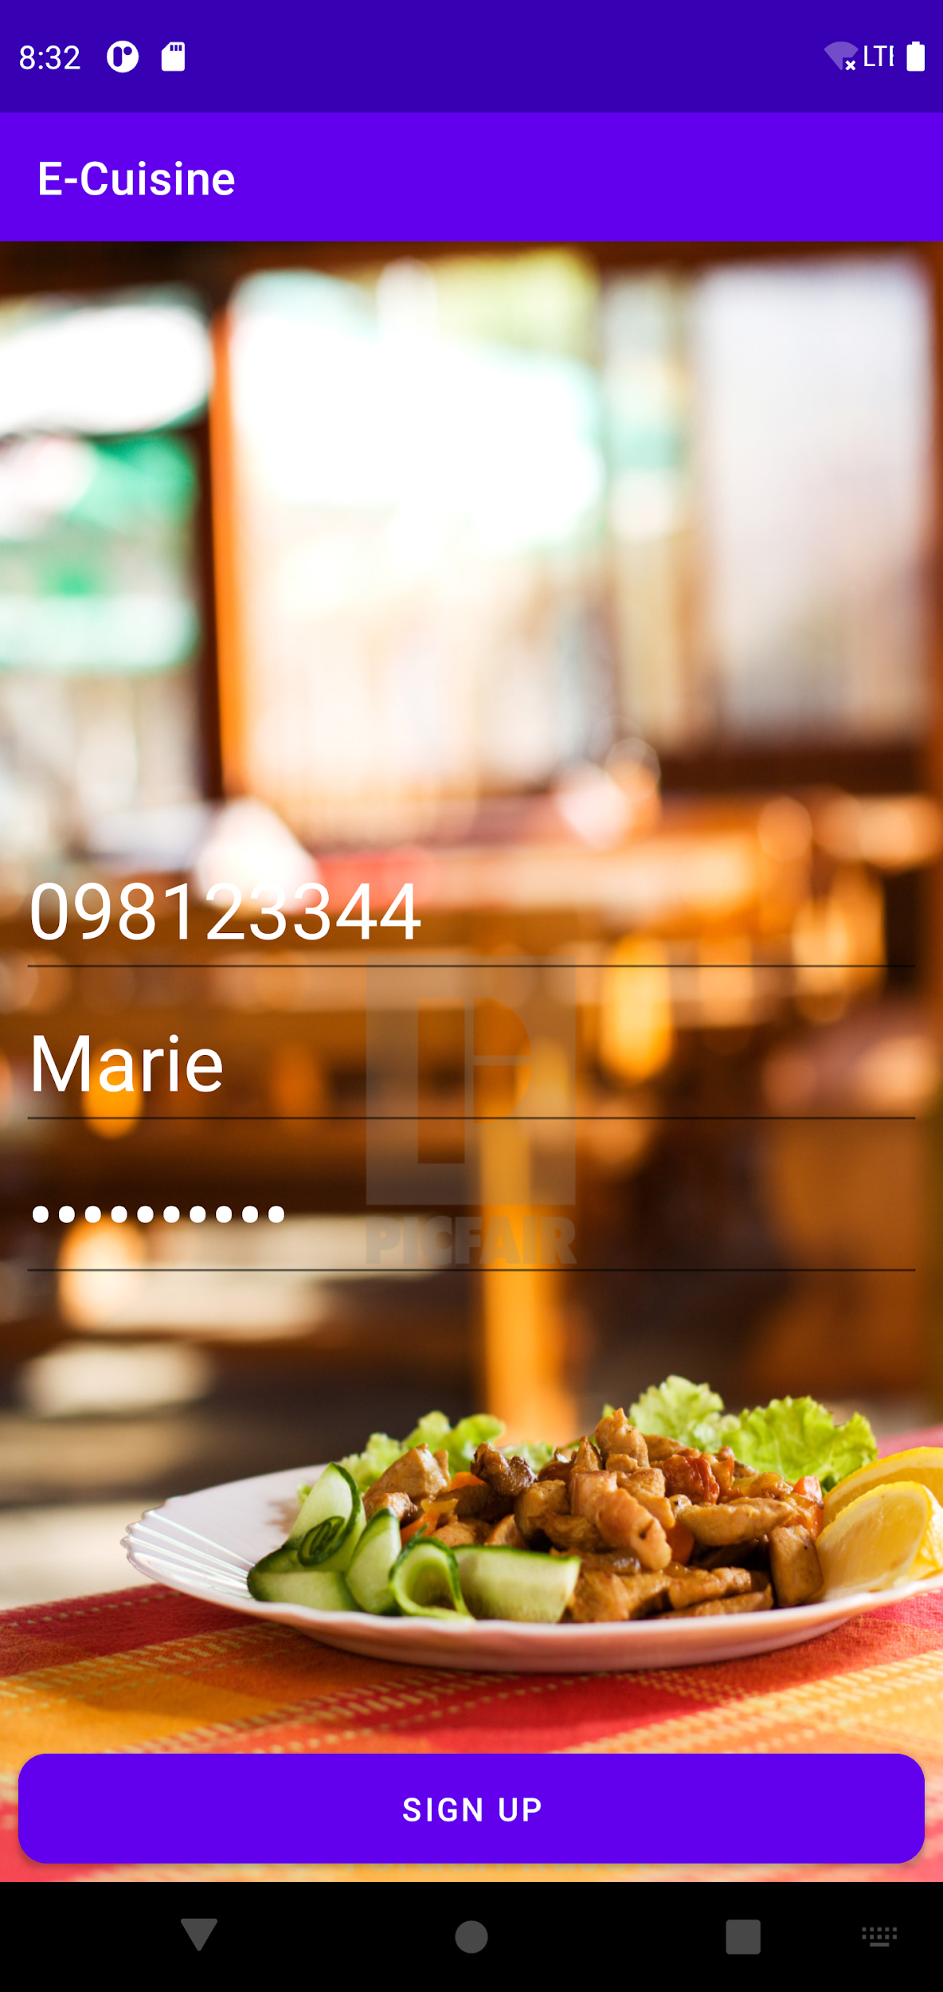
USER STORIES
As a User :
I want to Register to the Application so that I can Login.
Given
I enter credentials for registration
When
I click SignUp
Then
I can register to the system and re-directed to the home page.

Slide 6
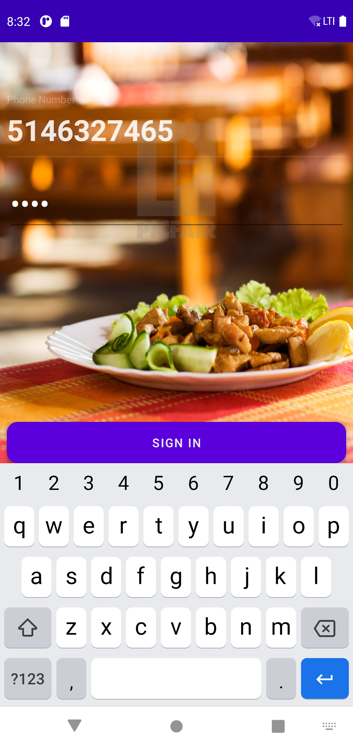
As a User :
I want to Login so that I can see my Dashboard.
Given
I am registered into application
When
I click login
Then
I can see my home Page with Menu option and Food Category

Slide 7
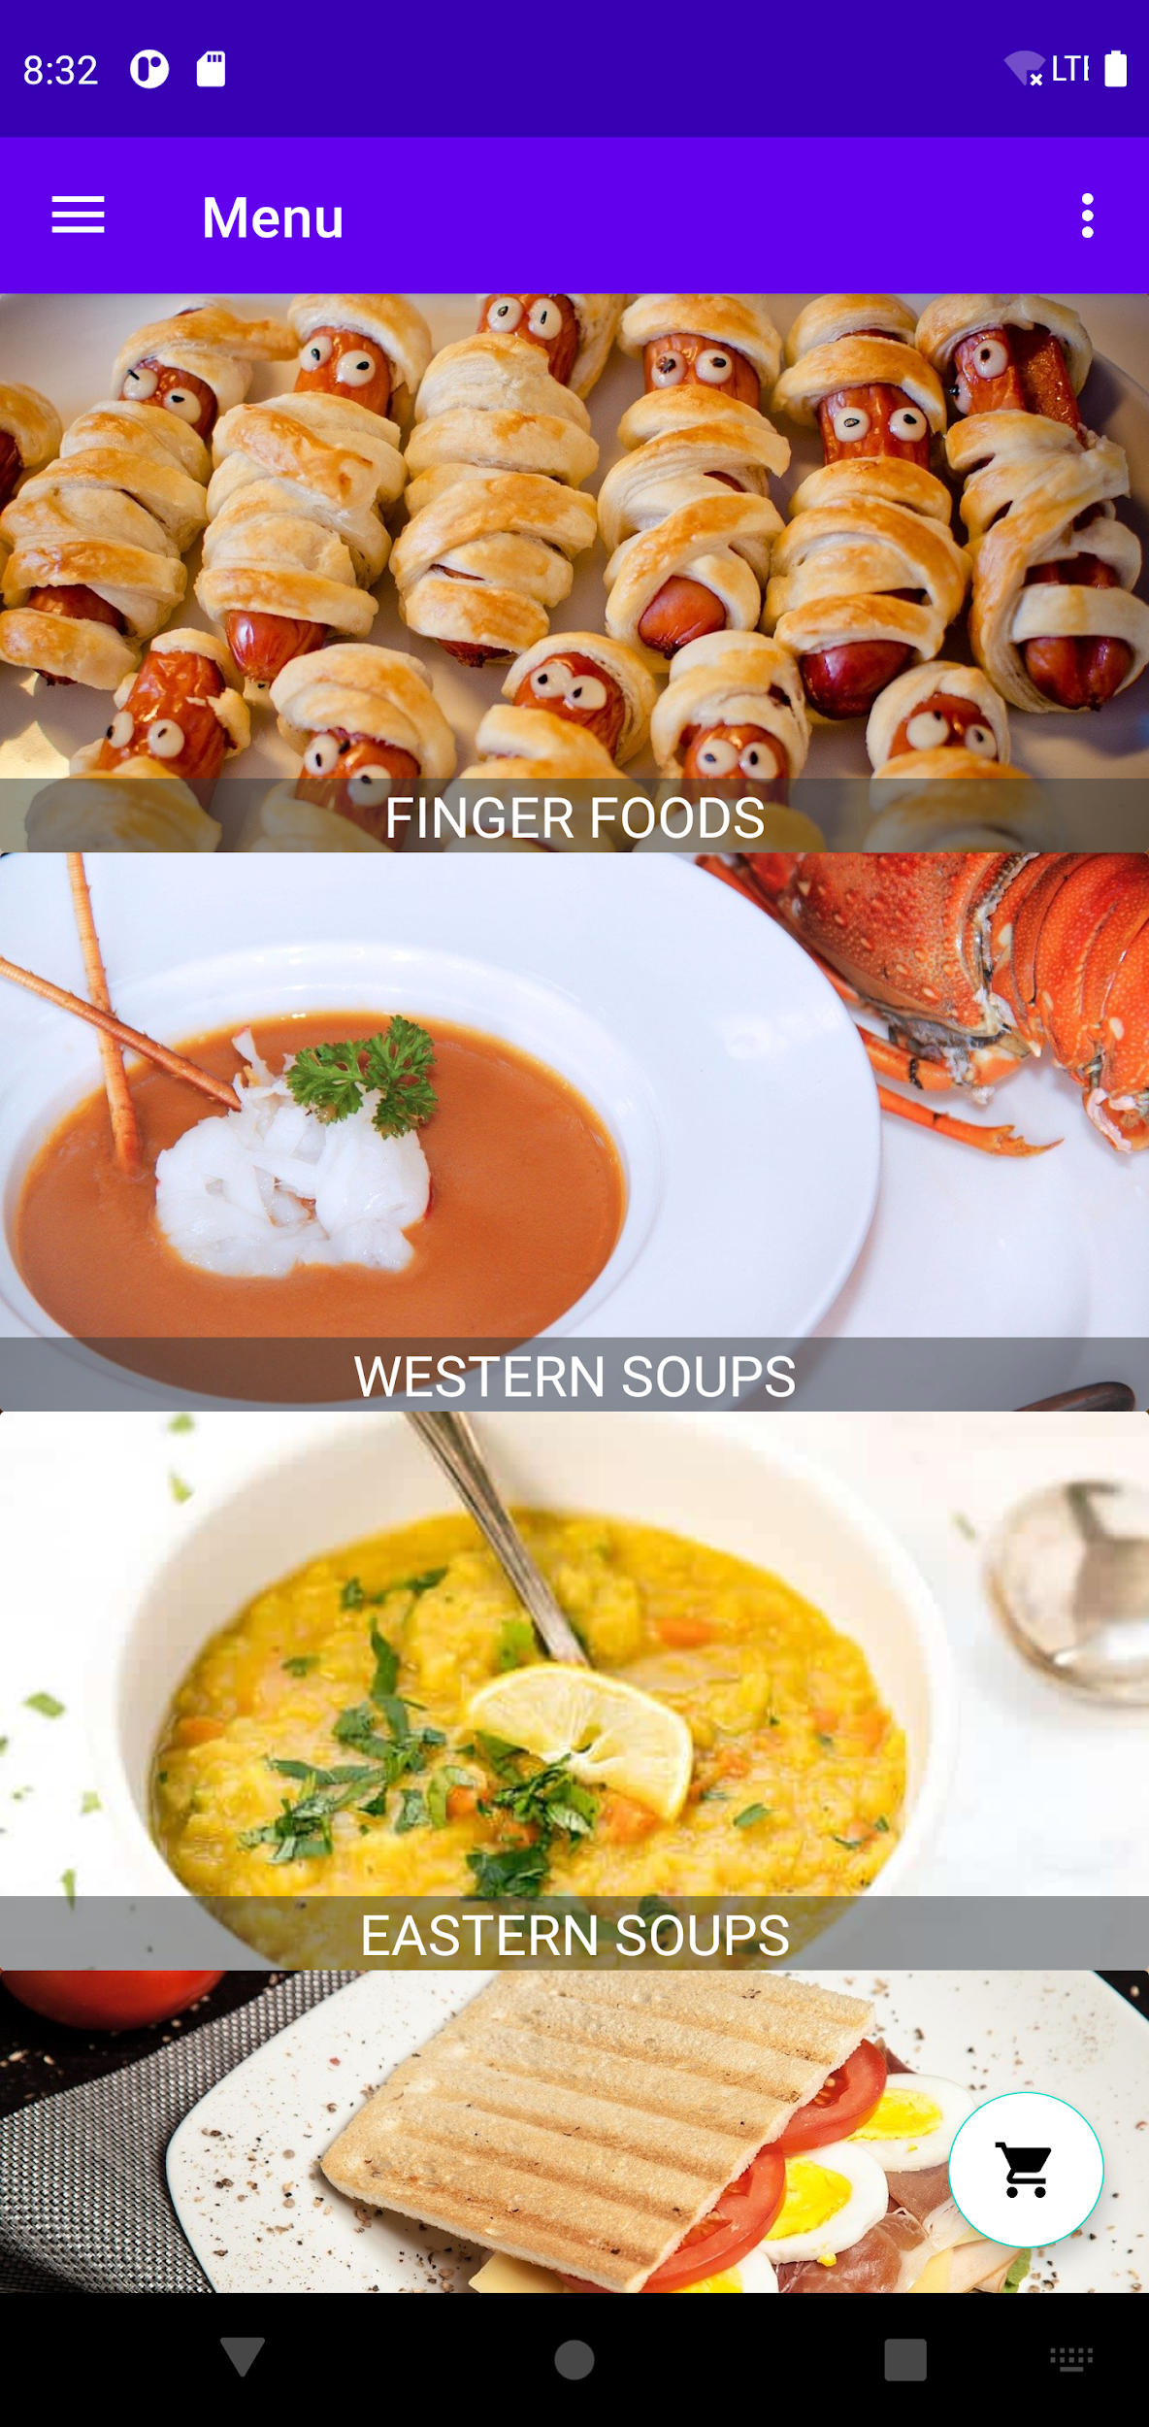
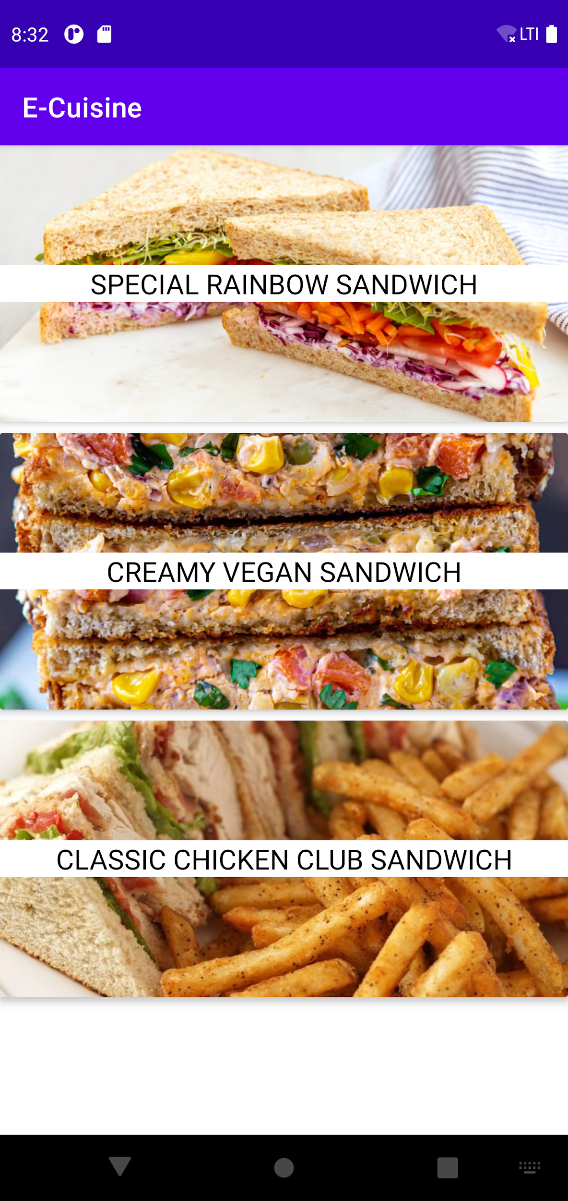
As a User :
I want to view all the Food in Category so that I can see food items.
Given
I am logged into application
When
I click on any of the food category
Then
I can see all food items related to category

Slide 8
As a User :
I want to add the food items to the cart
Given
I am on view food page
When
I tap on to food items
Then
I can add my food item into the cart.

Slide 9
As a User :
I want to view my cart items so that I can know to which food items I have chosen.
Given
I am on my home page
When
I click on Cart
Then
I am able to see food items added into cart

Slide 10
As a User :
I am able to fill shipping details to place my order
Given
I am on my cart
I click on Place Order
When
Then
the pop-up window should be opened with the form and able to fill a address details

Slide 11
As a User :
I am able to place an order
Given
I am on my address detail page
When
I click on confirm
Then
I should be able to place order successfully

Slide 12
As a User :
I want to place order so that restaurant can view the orders.
Given
I am on my dashboard
When
I click on Order
Then
I can place order so that the restaurant can view it

Slide 13
As a User :
I want to view order status so that I can keep track of status.
Given
I am on my dashboard
When
I click on Order
Then
I can view my order details

Slide 14
As a User :
I want to Edit my Profile so that I can update my information.
Given
I am on Edit Profile
When
I edit my information
Then
I can update my profile.

Slide 15
As a User :
I want to Write a review so that I can give feedback on restaurant.
Given
I am Login to the application
When
I click on Feedback
Then
I can write a review about the restaurant

Slide 16
SELLER STORIES
As a Seller :
I want to Register so that I can register my restaurant in the application.
Given
I enter credentials for registeration
When
I click Register
Then
I can register to the application and re-directed to the Login page.

Slide 17
As a Seller :
I want to Login so that I can see my Dashboard.
Given
I am registered to application
When
I click on login
Then
I can see my dashboard with my profile.

Slide 18
As a Seller :
I want to add food items according to the category so that users can view and buy them
Given
I am on food items Page
When
I click on Add food item
Then
I can add and enter details of my food item so that users can buy.

Slide 19
As a Seller :
I want to delete the food item that are no longer available so that user do not have access to those food items and the status of food item change to unavailable
Given
I am on food item Page
When
I click on Delete food item
Then
I can delete or remove food item that are no longer available.

Slide 20
As a Seller :
I want to see the order details so that I can process the orders so that the client get to know about their order status.
Given
I am on Dashboard
When
I click view on Orders
Then
I can see all the orders received for the restaurant.

Slide 21
As a Seller :
I want to Edit my Profile so that I can update my information.
Given
I am on Edit Profile
When
I edit my information
Then
I can update my profile.

Slide 22
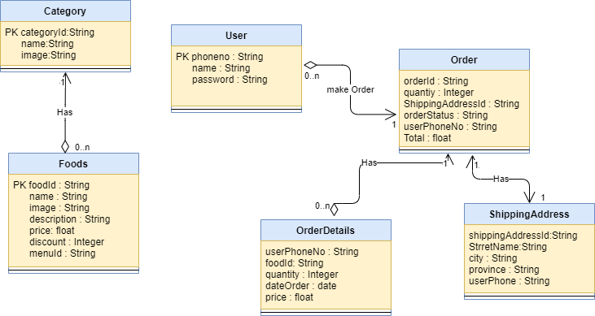
CLASS DIAGRAM

Slide 23
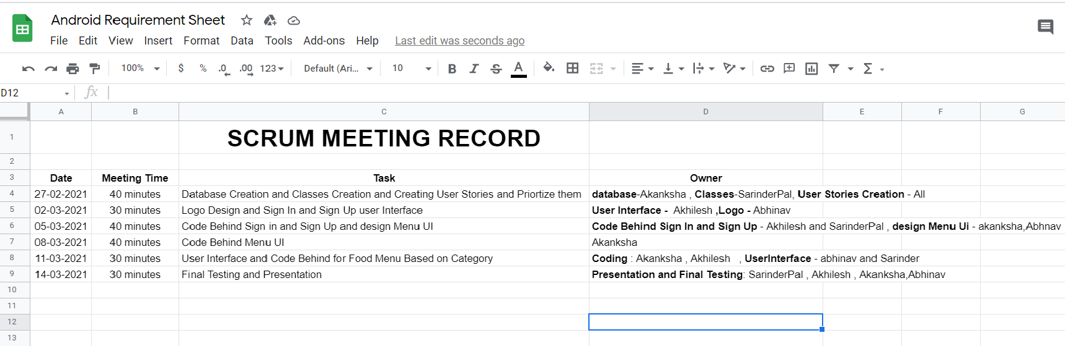
MEETING RECORD

Slide 24
MAJOR ITEMS THAT WENT WELL
User Interface designing
Preparing Presentation
Preparing Logo
Coding Behind prioritize user stories.
AREAS NEED TO IMPROVED IN NEXT SPRINT
Time Management : Tasks need to be done at a time given.
Team Management : Miscommunication between team members need to be improved.

